Slide 1
Measures of Central Tendency

Slide 2
Types of Measures of Central Tendency
Arithmetic Mean
Geometric Mean
Harmonic Mean
Mode
Median

Slide 3
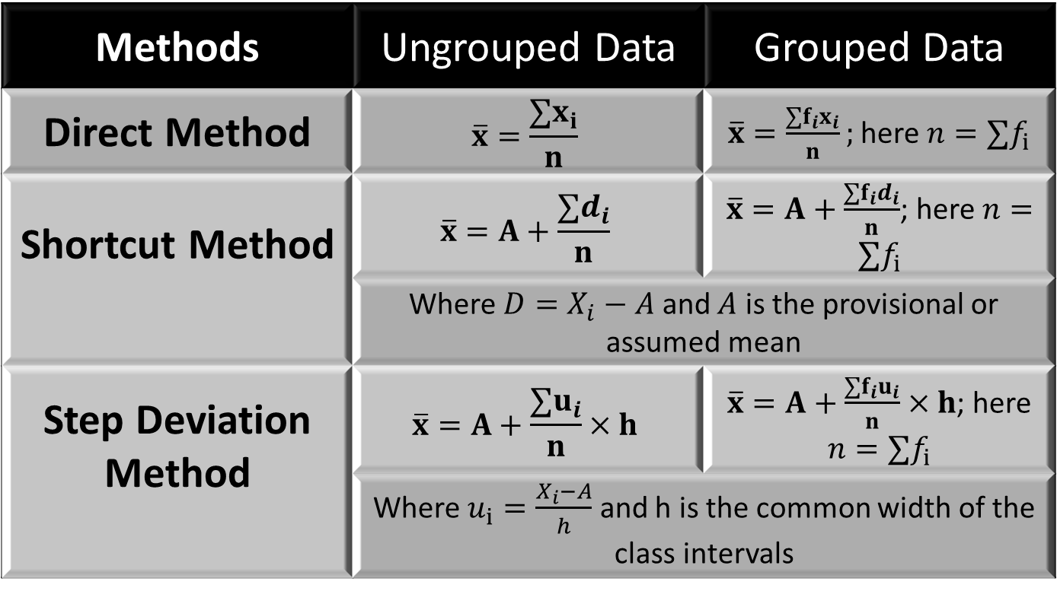

Arithmetic Mean
$$Mean=\frac{Sum of observations}{Number of observations}$$
Methods | Ungrouped Data | Grouped Data
Direct Method | $$\overline{x}=\frac{∑x_{i}}{n}$$ | $\overline{x}=\frac{∑f_{i}x_{i}}{n};$ here $n=∑f_{i}$
Shortcut Method | $$\overline{x}=A+\frac{∑d_{i}}{n}$$ | $\overline{x}=A+\frac{∑f_{i}d_{i}}{n}$; here $n=∑f_{i}$
 | Where $D=X_{i}−A$ and $A$ is the provisional or assumed mean
Step Deviation Method | $$\overline{x}=A+\frac{∑u_{i}}{n}×h$$ | $\overline{x}=A+\frac{∑f_{i}u_{i}}{n}×h$; here $n=∑f_{i}$
 | Where $u_{i}=\frac{X_{i}−A}{h}$ and h is the common width of the class intervals

Slide 4
AM for ungrouped data
Calculate the arithmetic mean for the marks obtained by 10 students of EEE are as follows:
The management of an electrical components factory wants to know the monthly production pattern of different units. In this connection, a survey was conducted on 50 units of the factory. The following data give the number of units produced per month by 50 different machines:
140, 144, 187, 184, 87, 40, 122, 203, 148, 150, 165, 133, 195, 151, 71,94, 87, 42, 30, 62, 103, 204, 162, 149, 79, 163, 69, 121, 93, 143, 110, 175, 161, 157, 155, 108, 164, 128, 114, 178, 130, 156, 167, 124, 164, 146, 116, 149, 104, 141.
$$x_{i}$$ | 45 | 32 | 37 | 46 | 39 | 36 | 41 | 48 | 36
Notes:
Observations available in the raw form are called ungrouped data

Slide 5
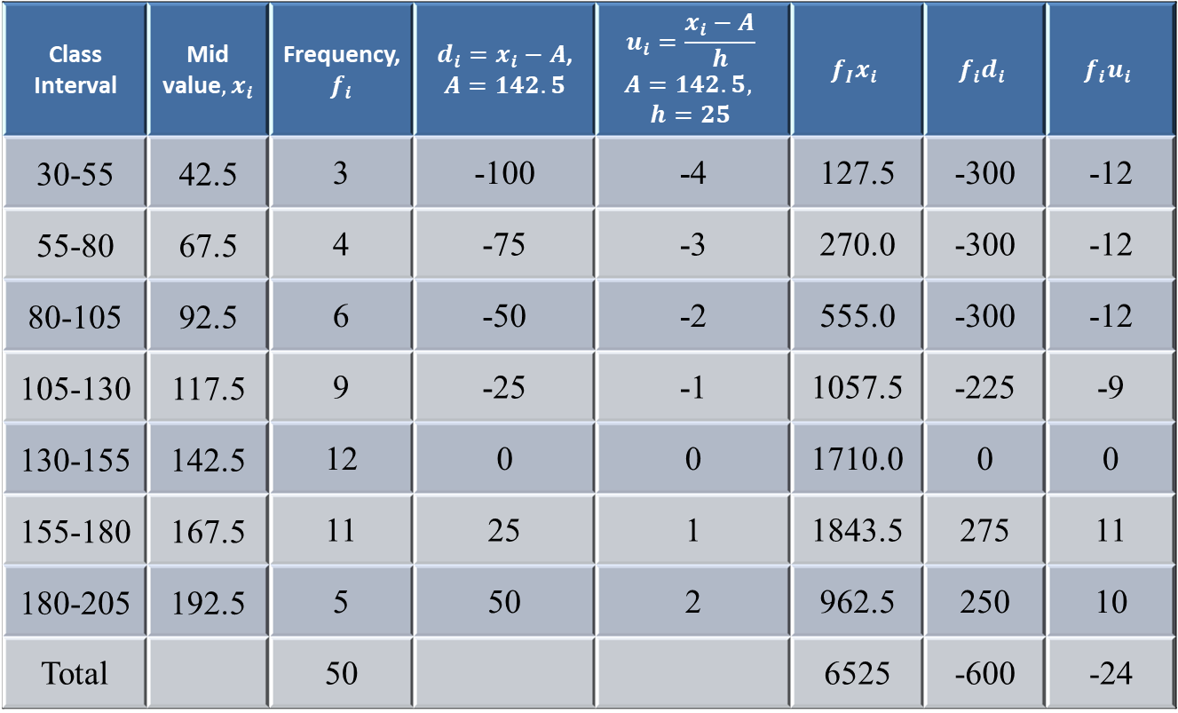
AM for grouped data
Class Interval | Mid value${, x}_{i}$ | Frequency, $f_{i}$ | $d_{i}=x_{i}−A$, $$A=142.5$$ | $$u_{i}=\frac{x_{i}−A}{h}$$ $$A=142.5,$$ $$h=25$$ | $$f_{I}x_{i}$$ | $$f_{i}d_{i}$$ | $$f_{i}u_{i}$$
30-55 | 42.5 | 3 | -100 | -4 | 127.5 | -300 | -12
55-80 | 67.5 | 4 | -75 | -3 | 270.0 | -300 | -12
80-105 | 92.5 | 6 | -50 | -2 | 555.0 | -300 | -12
105-130 | 117.5 | 9 | -25 | -1 | 1057.5 | -225 | -9
130-155 | 142.5 | 12 | 0 | 0 | 1710.0 | 0 | 0
155-180 | 167.5 | 11 | 25 | 1 | 1843.5 | 275 | 11
180-205 | 192.5 | 5 | 50 | 2 | 962.5 | 250 | 10
Total |  | 50 |  |  | 6525 | -600 | -24
Notes:
Any number can serve the purpose of arbitrary point 'A' but. usually, the value of x corresponding to the middle part of the distribution will be much more convenient

Slide 6

AM for grouped Data
Direct Method,
$$\overline{x}=\frac{∑f_{i}x_{i}}{n}$$
Shortcut Method,
$$\overline{x}=A+\frac{∑f_{i}d_{i}}{n}$$
Step Deviation Method,
$$\overline{x}=A+\frac{∑f_{i}u_{i}}{n}×h$$

Slide 7

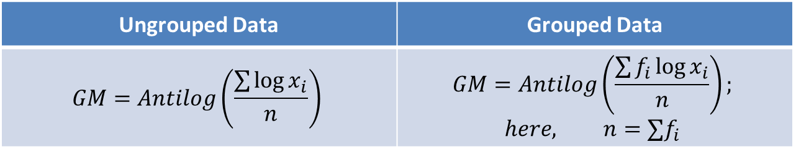
Geometric Mean
Geometric Mean: The n^{th} root of the product of “n” positive values is called Geometric Mean.
$$GM=\sqrt[n]{Product of n positive values}$$
The following are the formula of Geometric mean:
Numerical Example for both grouped and ungrouped data:
Calculate the arithmetic mean for the marks obtained by 10 students of EEE are as follows:
Ungrouped Data | Grouped Data
$$GM=Antilog\left(\frac{\sum{\log{x_{i}}}}{n}\right)$$ | $$GM=Antilog\left(\frac{\sum{f_{i}\log{x_{i}}}}{n}\right);$$ $$here, n=∑f_{i}$$
$$x_{i}$$ | 45 | 32 | 37 | 46 | 39 | 36 | 41 | 48 | 36
Notes:
AM and GM for 2,8 & 2,4,8 & -4,-16 are $AM=\frac{2+8}{2}=5, GM=\sqrt[2]{2×8}=4$; $AM=\frac{2+4+8}{3}=4.67$, $GM=\sqrt[3]{2×4×8}=8$. here, negative values example can be taken as someone borrowed money from his 2 friends of Tk. 4 and 16 respectively, then average amount he borrowed is $AM=\frac{−4−16}{2}=−10$, whereas $GM=\sqrt[2]{\left(−4\right)×\left(−16\right)}=8,$which is a positive value means that you are getting 8 taka per person not you owe them any money.

Slide 8

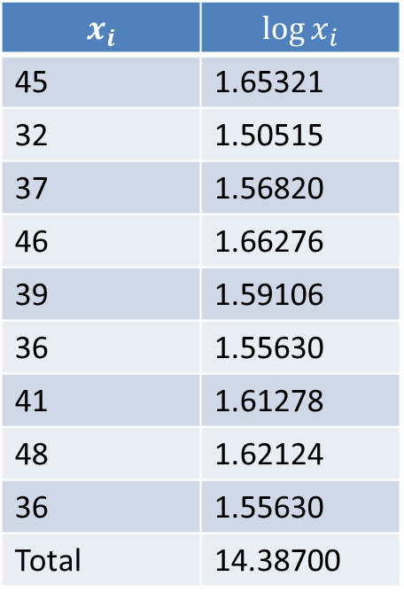
GM for ungrouped data
$$x_{i}$$ | $$\log{x_{i}}$$
45 | 1.65321
32 | 1.50515
37 | 1.56820
46 | 1.66276
39 | 1.59106
36 | 1.55630
41 | 1.61278
48 | 1.62124
36 | 1.55630
Total | 14.38700
$$GM=Antilog\left(\frac{\sum{\log{x_{i}}}}{n}\right)$$
$$=antilog\left(\frac{14.38700}{9}\right)$$
$$=antilog\left(1.59856\right)$$
$$GM=39.68$$

Slide 9

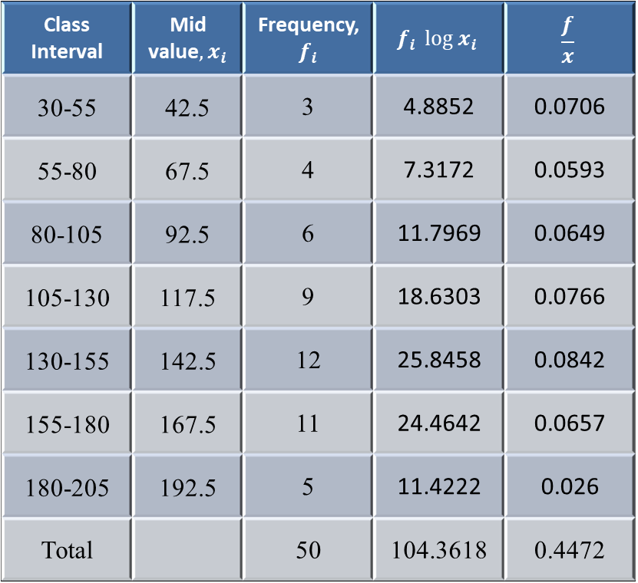
GM for grouped data
Class Interval | Mid value${, x}_{i}$ | Frequency, $f_{i}$ | $$f_{i} \log{x_{i}}$$ | $$\frac{f}{x}$$
30-55 | 42.5 | 3 | 4.8852 | 0.0706
55-80 | 67.5 | 4 | 7.3172 | 0.0593
80-105 | 92.5 | 6 | 11.7969 | 0.0649
105-130 | 117.5 | 9 | 18.6303 | 0.0766
130-155 | 142.5 | 12 | 25.8458 | 0.0842
155-180 | 167.5 | 11 | 24.4642 | 0.0657
180-205 | 192.5 | 5 | 11.4222 | 0.026
Total |  | 50 | 104.3618 | 0.4472
$$GM=Antilog\left(\frac{\sum{\log{x_{i}}}}{n}\right)$$
$$GM=122.2464$$

Slide 10
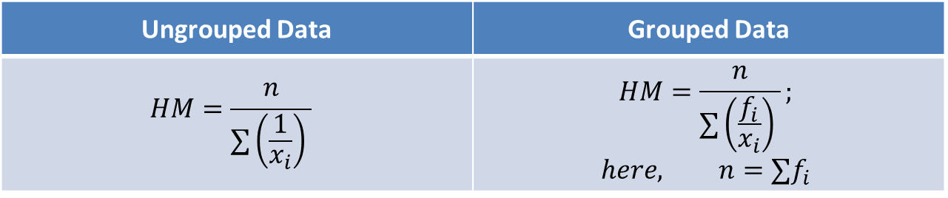

Harmonic Mean
The reciprocal of the Arithmetic mean of the reciprocal of the values is called Harmonic Mean
$$HM=reciprocal of \left(\frac{sum of reciprocal of the values}{The number of values}\right)$$
The following formulae are for Harmonic Mean :
Calculate the harmonic mean for the following data
Ungrouped Data | Grouped Data
$$HM=\frac{n}{∑\left(\frac{1}{x_{i}}\right) }$$ | $$HM=\frac{n}{∑\left(\frac{f_{i}}{x_{i}}\right) };$$ $$here, n=∑f_{i}$$
$$x_{i}$$ | 45 | 32 | 37 | 46 | 39 | 36 | 41 | 48 | 36

Slide 11

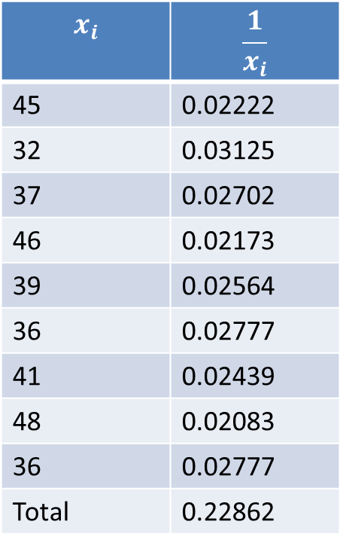
Harmonic Mean
$$x_{i}$$ | $$\frac{1}{x_{i}}$$
45 | 0.02222
32 | 0.03125
37 | 0.02702
46 | 0.02173
39 | 0.02564
36 | 0.02777
41 | 0.02439
48 | 0.02083
36 | 0.02777
Total | 0.22862
$$HM=\frac{n}{∑\left(\frac{1}{x_{i}}\right) }$$
$$=\frac{9}{0.22862}$$
$$HM=39.36663$$

Slide 12

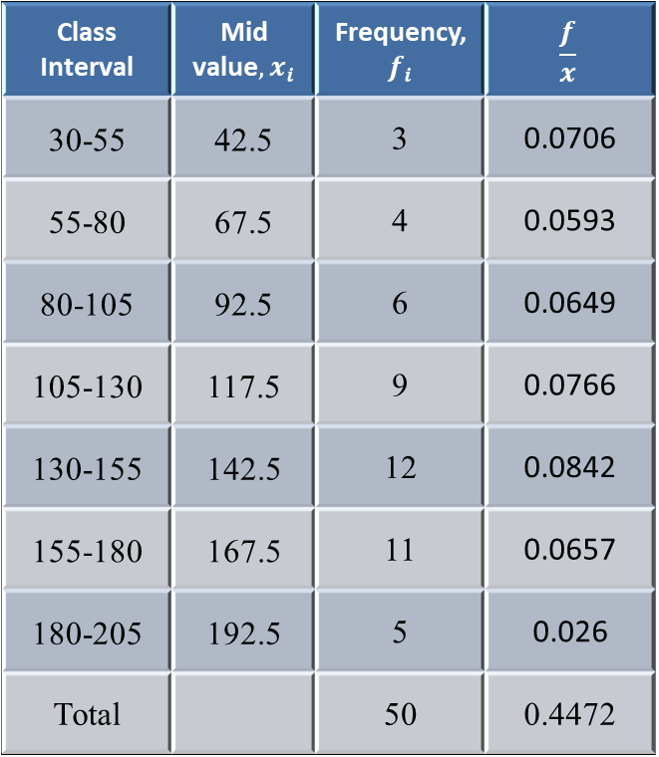
Harmonic Mean
Class Interval | Mid value${, x}_{i}$ | Frequency, $f_{i}$ | $$\frac{f}{x}$$
30-55 | 42.5 | 3 | 0.0706
55-80 | 67.5 | 4 | 0.0593
80-105 | 92.5 | 6 | 0.0649
105-130 | 117.5 | 9 | 0.0766
130-155 | 142.5 | 12 | 0.0842
155-180 | 167.5 | 11 | 0.0657
180-205 | 192.5 | 5 | 0.026
Total |  | 50 | 0.4472
$$HM=\frac{n}{∑\left(\frac{f_{i}}{x_{i}}\right) }$$
$$=\frac{50}{0.4472}$$
$$=111.8068$$

Slide 13
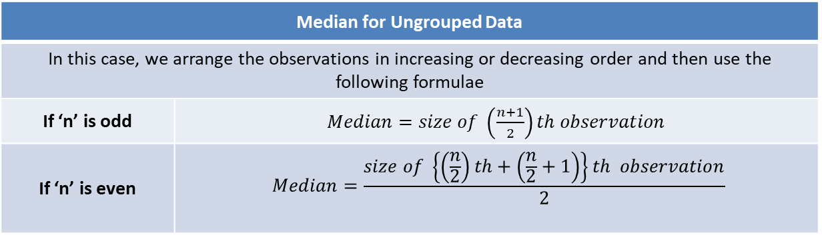

Median
Median for Ungrouped Data
In this case, we arrange the observations in increasing or decreasing order and then use the following formulae
If ‘n’ is odd | $Median=size of \left(\frac{n+1}{2}\right)th observation$
If ‘n’ is even | $$Median=\frac{size of \left\{\left(\frac{n}{2}\right)th+\left(\frac{n}{2}+1\right)\right\}th observation}{2}$$
Numerical Example of Median for both grouped and ungrouped data:
Arrange the Data in ascending order:
$$32, 36, 36, 37, 39, 41, 45, 46, 48$$
Here, $n=9$ is odd
$$Median=size of \left(\frac{n+1}{2}\right)th observation=Size of 5th observation=39$$
$$x_{i}$$ | 45 | 32 | 37 | 46 | 39 | 36 | 41 | 48 | 36

Slide 14

Median
Calculate the median for the following data:
Arrange in ascending order:
$$32, 36, 36, 37, 39, 41, 45, 46, 48, 50$$
Here, $n=10$ is even
$$Median=\frac{size of \left\{\left(\frac{n}{2}\right)th+\left(\frac{n}{2}+1\right)\right\}th observations}{2}$$
$$=\frac{size of \left(\frac{10}{2}th+\left(\frac{10}{2}+1\right)th\right) observations}{2}$$
$$=\frac{size of \left(5th+6th\right) observations}{2}$$
$$=40$$
The number of values above the median balances (equals) the number of values below the median $i.e., 50\%$of the data falls above and below the median.
$$x_{i}$$ | 45 | 32 | 37 | 46 | 39 | 36 | 41 | 48 | 36 | 50

Slide 15
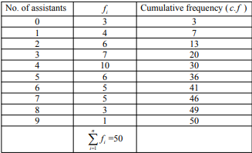
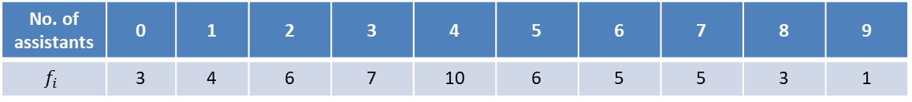

Median for discrete Data
The following distributions relates to the number of assistants in 50 retail stores.
No. of assistants | 0 | 1 | 2 | 3 | 4 | 5 | 6 | 7 | 8 | 9
$$f_{i}$$ | 3 | 4 | 6 | 7 | 10 | 6 | 5 | 5 | 3 | 1
$$Median=\frac{size of \left(\frac{50}{2}th+\left(\frac{50}{2}+1\right)th\right) observations}{2}$$
$$=\frac{size of \left(25th+26th\right) observations}{2}$$
$$=\frac{4+4}{2}=4$$

Slide 16

Median from continuous Grouped Data
Construct the class boundaries if the classes are discontinuous.
Find cumulative frequencies
Determine the median class using$\frac{n}{2}$
Use the formula
$$M_{e}=L+\frac{\left(\frac{n}{2}−F\right)}{f}×c$$
where,
$$L=Lower class limit of Median class$$
$$n=Total number of obsservations$$
$$F=Cumulative frequency of pre−median class$$
$$f=Frequency of median class$$
$$c=class width$$

Slide 17

Median for grouped data
Class Interval | Frequency | Cumulative Frequency
30-55 | 3 | 3
55-80 | 4 | 7
80-105 | 6 | 13
105-130 | 9 | 22
130-155 | 12 | 34
155-180 | 11 | 45
180-205 | 5 | 50
Total | 50
Here, $M_{e}=L+\frac{\left(\frac{n}{2}−F\right)}{f}×c$
$$=130+\frac{25−22}{12}×25$$
$$=130+6.25$$
$$=136.25$$

Slide 18

Mode
A value that occurs most frequently in a data set
Three types of mode
Uni-modal
Bi-modal
Multi-modal
In case of discrete grouped data modal value is one with largest frequency
Continuous grouped data:
Class that carries the highest frequency is the modal class
Using the formula
$$M_{o}=L+\frac{Δ_{1}}{Δ_{1}+Δ_{2}}×i$$
$$L=Lower limit of the modal class$$
$$Δ_{1}=Difference between the modal class and pre−modal class$$
$$Δ_{2}=Difference between the modal class and post−modal class$$
$$i=size of the modal class$$

Slide 19

Mode
Class Interval | Frequency | Cumulative Frequency
30-55 | 3 | 3
55-80 | 4 | 7
80-105 | 6 | 13
105-130 | 9 | 22
130-155 | 12 | 34
155-180 | 11 | 45
180-205 | 5 | 50
Total | 50
$$M_{o}=L+\frac{Δ_{1}}{Δ_{1}+Δ_{2}}×i$$
$$=130+\frac{12−9}{\left(12−9\right)+(12−11)}×25$$
$$=148.75$$

Slide 20
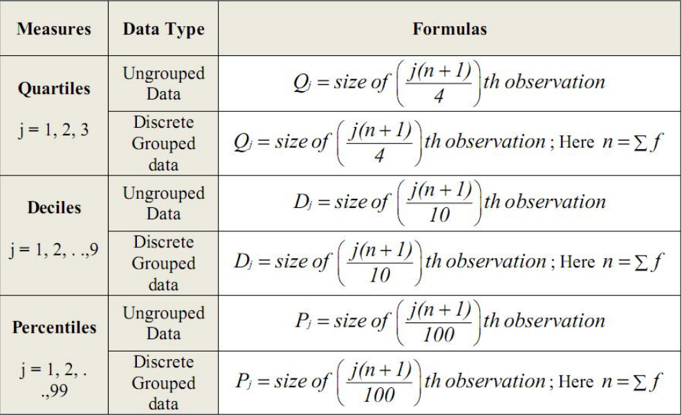

Slide 21
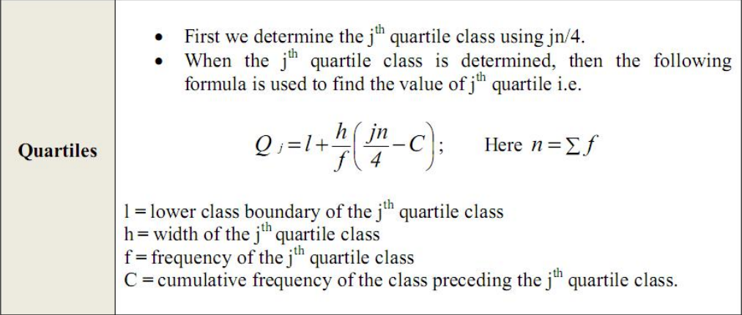
Quartiles

Slide 22
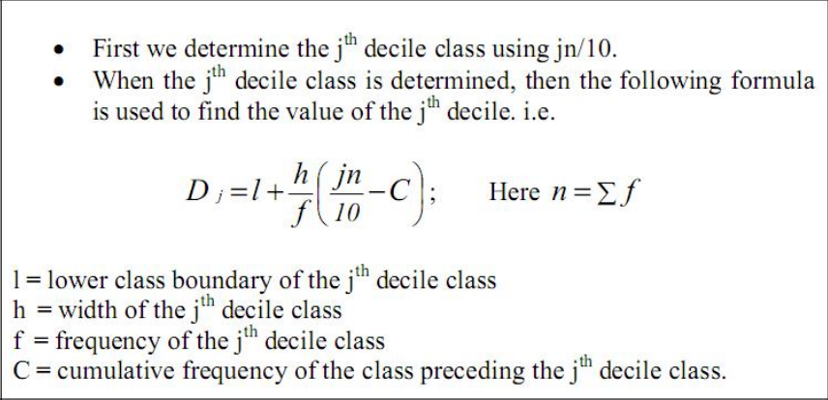
Deciles

Slide 23
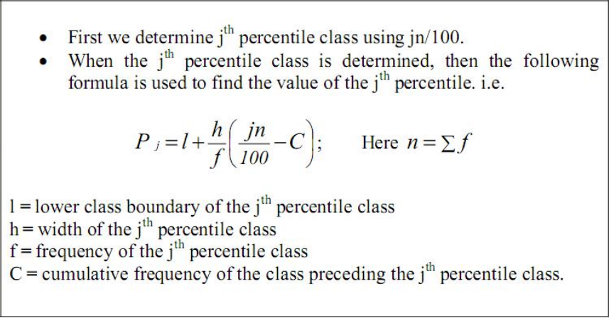
Percentiles

